Slide 1
GCI WORLD 2026 APRIL · FINAL ASSIGNMENT · PoC PROPOSAL
Turning Customer Data into Retained Revenue
A machine-learning churn-prevention proposal for Company A (Telecom)
Prepared by: Daniela Chavez
IT Consulting — Data Science Associate
Matsuo–Iwasawa Laboratory, The University of Tokyo

Slide 2
THE BOTTOM LINE FIRST
Executive Summary
Company A loses nearly half its customers. A data-driven, ML-targeted retention program can recover ~$6M in revenue at almost no incremental cost.
49.6%
0.69
1.67x
$6.0M
Customer churn rate
Model ROC-AUC
Lift in top 5% at-risk
Net benefit (24-mo)
▪ Problem: ≈49.6% of ~100,000 customers churn within the 31–60 day window — a major recurring revenue leak.
▪ Solution: A monthly churn-risk scoring engine ranks customers so the retention team targets the highest-risk segment first.
▪ Evidence: Gradient Boosting (ROC-AUC 0.69) identifies churners 1.5–1.7× better than random targeting.
▪ Impact: Targeting the top 20% yields ~$6.0M net benefit and ~$2.0M more than untargeted outreach.
2

Slide 3
INDUSTRY ANALYSIS
Market Context: Why Churn Is the Battleground
▪ US telecom is a ~$650B market [1] — mature, saturated, and fiercely competitive.
▪ Annual churn averages 20–30% across wireless carriers [2]; acquisition is largely zero-sum.
▪ Acquiring a new customer costs 5–7× more than retaining an existing one [3].
▪ A 5% lift in retention can raise profits 25–95% (Reichheld & Sasser) [4].
▪ Implication: with little room to grow the pie, defending the existing base is the highest-ROI lever available to Company A.
THE RETENTION ECONOMICS
5–7×
cost to acquire vs. retain a customer
25–95%
potential profit increase from a
5% improvement in retention
Sources: [1] IBISWorld/Statista 2024 · [2] McKinsey Telecom · [3] HBR · [4] Bain & Co. — full list on References slide.
3

Slide 4
PROOF OF CONCEPT DATASET
The Data We Were Given
▪ Two tables, joined on Customer_ID:
▪ • Client.csv — 100,000 customers × 50 demographic/account columns.
▪ • Record.csv — 100,000 rows × 51 usage/behavioral columns.
▪ Merged view: 100,000 customers × 100 features.
▪ Target variable: churn (1 = left within 31–60 days, 0 = stayed).
▪ Real-world messiness: many columns have missing values and ambiguous definitions — handled explicitly in preprocessing.
FEATURE FAMILIES
▪ Usage: minutes of use, calls placed/received, peak vs off-peak
▪ Revenue: monthly charge, overage, billing-adjusted totals
▪ Service quality: dropped / blocked / unanswered calls
▪ Equipment: handset price, equipment age, web capability
▪ Account: tenure (months), # subscribers, credit class
▪ Demographics: income, region, dwelling, household
Source: Company A PoC dataset (anonymized telecom provider), provided in course materials.
4

Slide 5
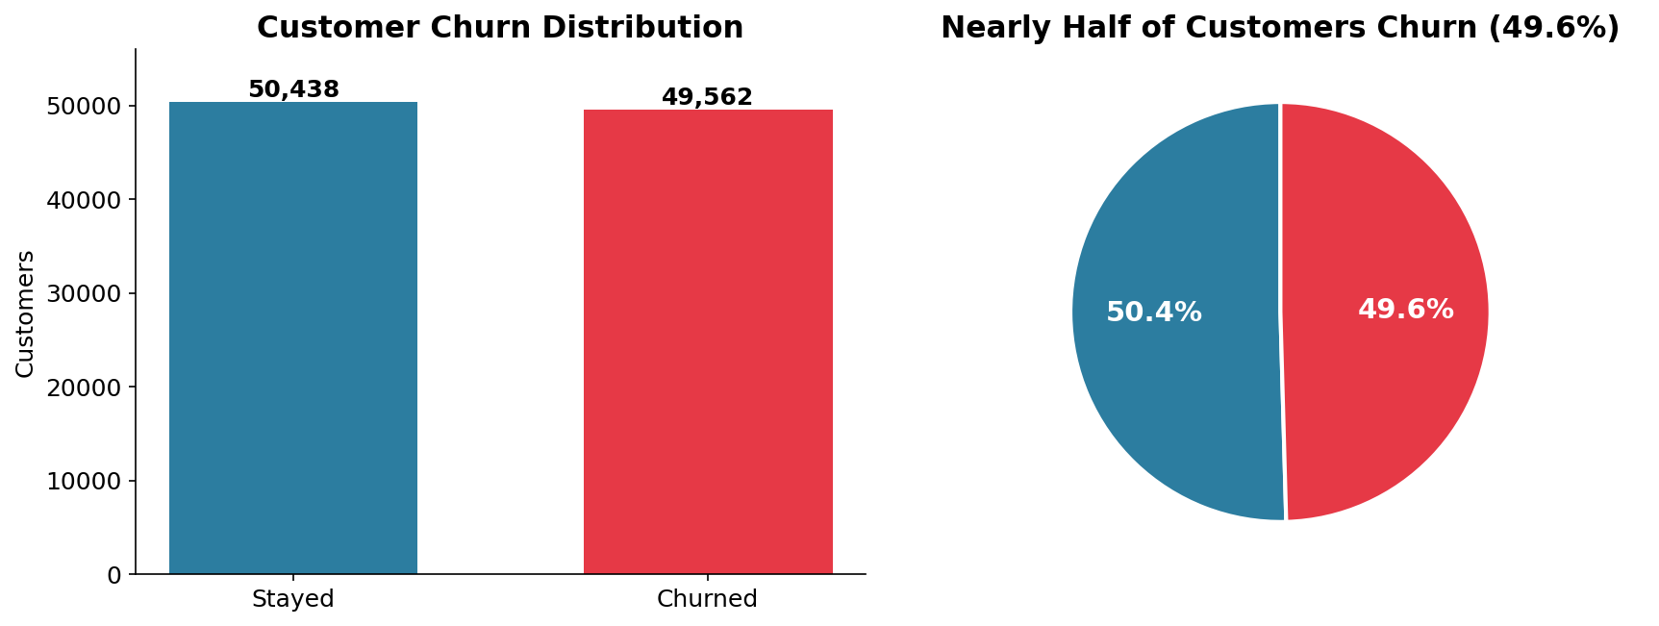
EXPLORATORY DATA ANALYSIS
Finding 1: Half the Base Is Walking Out
SO WHAT?
▪ 49.6% churn is extreme — almost a coin-flip on every customer.
▪ Even a small, well-targeted reduction protects millions in recurring revenue.
▪ The base is balanced, so the modeling challenge is ranking risk, not finding a rare event.
Analysis of merged Company A dataset (n = 100,000).
5

Slide 6
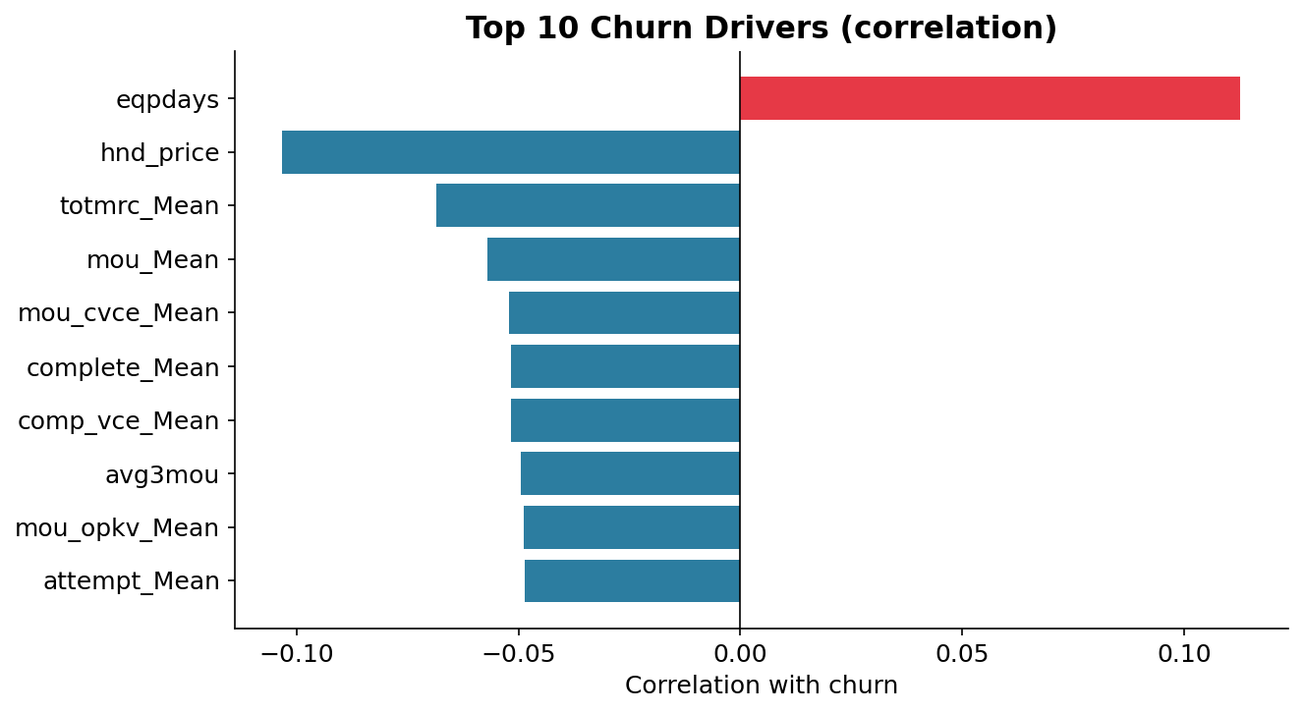
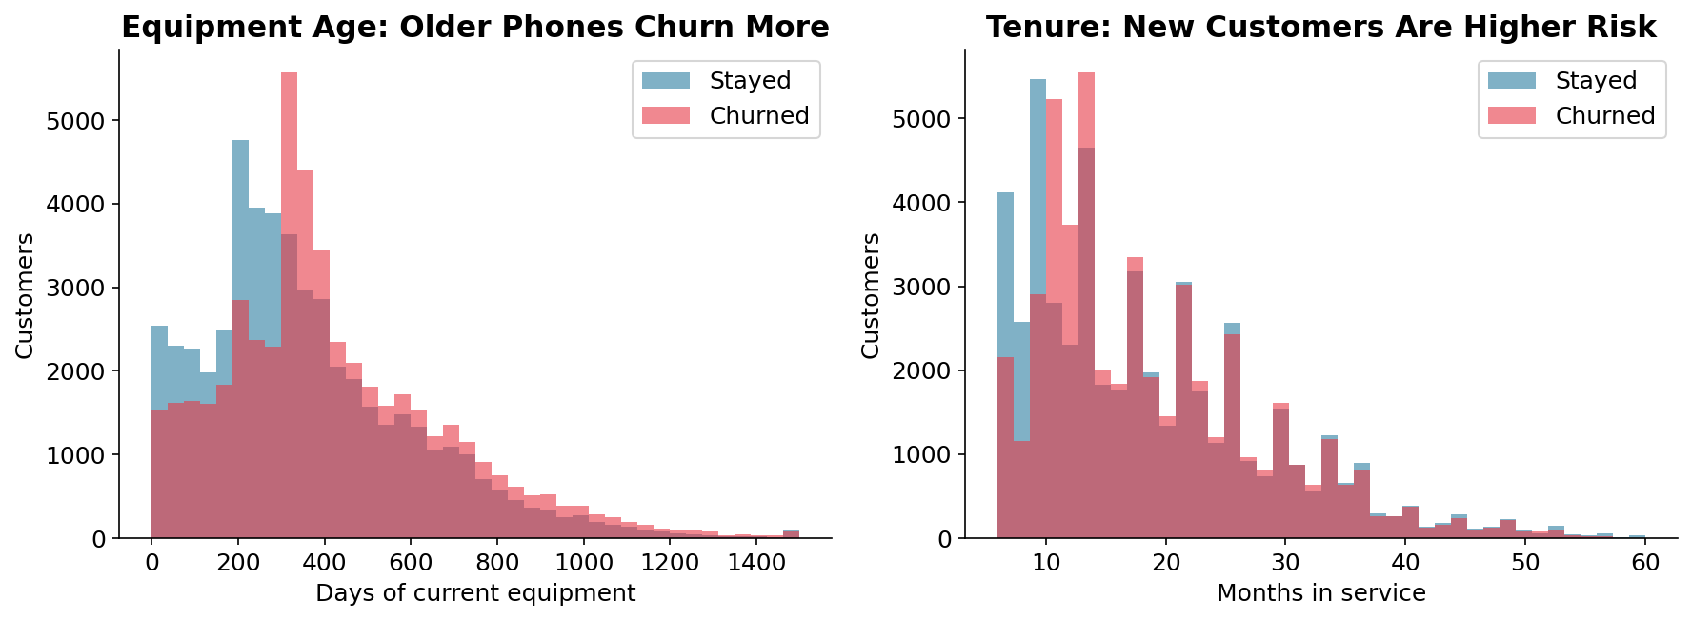
EXPLORATORY DATA ANALYSIS
Finding 2: What Separates Churners From Stayers
Equipment age and handset price are the strongest signals: customers on older, cheaper phones — and those with declining usage — are the most likely to leave. These map directly to actionable retention offers (device upgrades, loyalty perks).
Left: top correlations with churn. Right: distributions of equipment age and tenure by churn status.
6

Slide 7
FROM INSIGHT TO OBJECTIVE
Problem Definition & ML Task
BUSINESS OBJECTIVE
MACHINE-LEARNING TASK
Reduce revenue lost to churn by identifying — in advance — which customers are about to leave, so retention can act before they do.
Binary classification of churn, optimized to RANK customers by risk probability rather than to label them yes/no.
Why this framing?
▪ Target = churn — directly ties to the client's core profitability problem (validated in EDA).
▪ Metric = ROC-AUC — measures how well we RANK risk; insensitive to threshold, ideal when the plan is to contact a top-N list.
▪ Ranking > hard labels — the retention budget is finite, so we prioritize the customers most likely to churn AND worth saving.
7

Slide 8
HOW WE BUILT IT
Modeling Approach
▪ Preprocessing pipeline (leak-free):
▪ • Numeric — median imputation + standardization.
▪ • Categorical — most-frequent imputation + one-hot encoding.
▪ • Dropped high-cardinality / identifier columns.
▪ Feature engineering:
▪ • failure_ratio — dropped+blocked ÷ attempted calls (service quality).
▪ • rev_per_minute — revenue efficiency.
▪ • custcare_intensity — support-call rate (dissatisfaction proxy).
▪ Validation: stratified 80/20 split + 5-fold cross-validation, fixed random seed (reproducible).
MODELS COMPARED
▪ Logistic Regression — interpretable, transparent baseline.
▪ Decision Tree — captures simple non-linear rules.
▪ Gradient Boosting — ensemble of trees; strongest on tabular telecom data.
Each model handles class balance and is scored on identical folds, so the comparison is apples-to-apples.
Reproducible analysis in accompanying notebook (.ipynb).
8

Slide 9
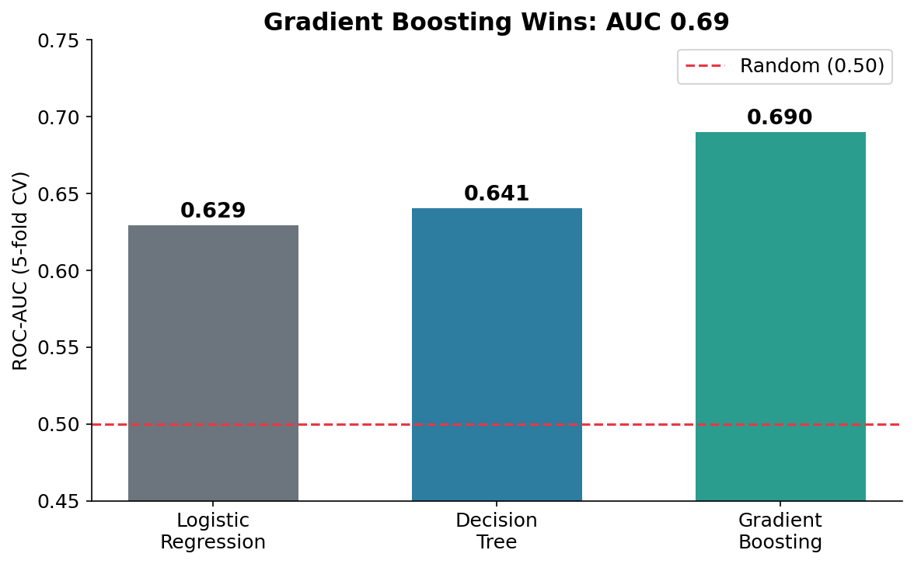
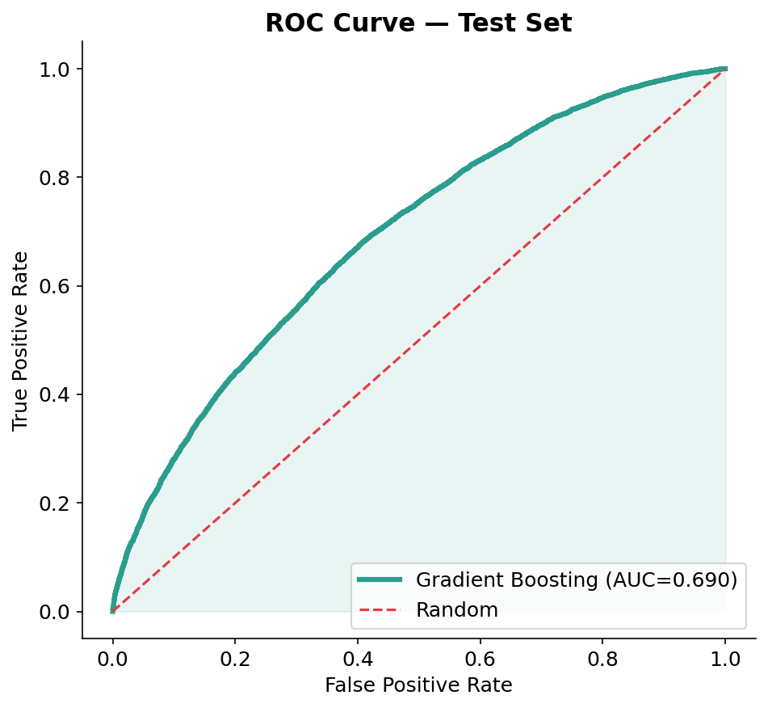
MODEL EVALUATION
Results: Gradient Boosting Is the Clear Winner
Model: Gradient Boosting Classifier · Metric: ROC-AUC · Score: 0.69 (test) — ~38% better than a random baseline (0.50).
5-fold CV: LogReg 0.629, Decision Tree 0.641, Gradient Boosting 0.690. Held-out test AUC: 0.690.
9

Slide 10
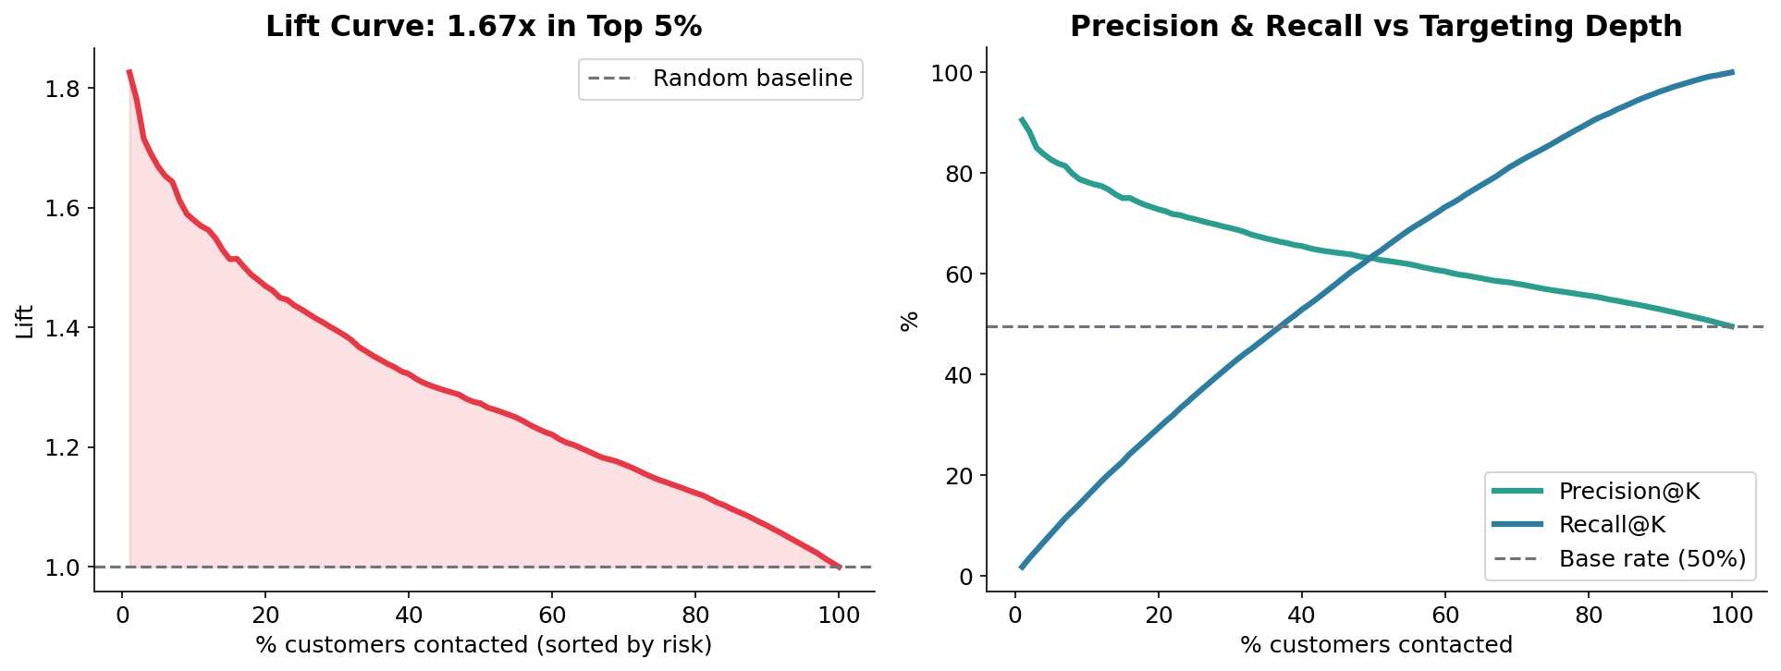
OPERATIONALIZING THE MODEL
From Prediction to Action: Who to Call First
READING THE CHART
▪ Top 5%: 83% are real churners — 1.67× better than random.
▪ Top 20%: 73% precision, capturing ~29% of all churners.
▪ Takeaway: a small, focused campaign captures a large share of churn risk cheaply.
Lift and precision/recall computed on the 20,000-customer held-out test set.
10

Slide 11
RECOMMENDED SOLUTION
The Proposal: A Monthly Churn-Risk Engine
1. SCORE
2. RANK & TARGET
3. INTERVENE
Every month, score all customers 0–1 for churn risk using the Gradient Boosting model.
Send the retention team a ranked list; focus on the top 20% highest-risk customers.
Trigger tailored offers — device upgrades, loyalty discounts, proactive support — by risk driver.
Why it works
▪ Targets the right people — EDA-validated drivers (old handsets, declining usage) map to concrete offers.
▪ Fits existing operations — plugs into the current retention team; no new infrastructure needed for the PoC.
▪ Spends efficiently — contacting 20% instead of 100% cuts campaign cost 5× while keeping most of the upside.
11

Slide 12
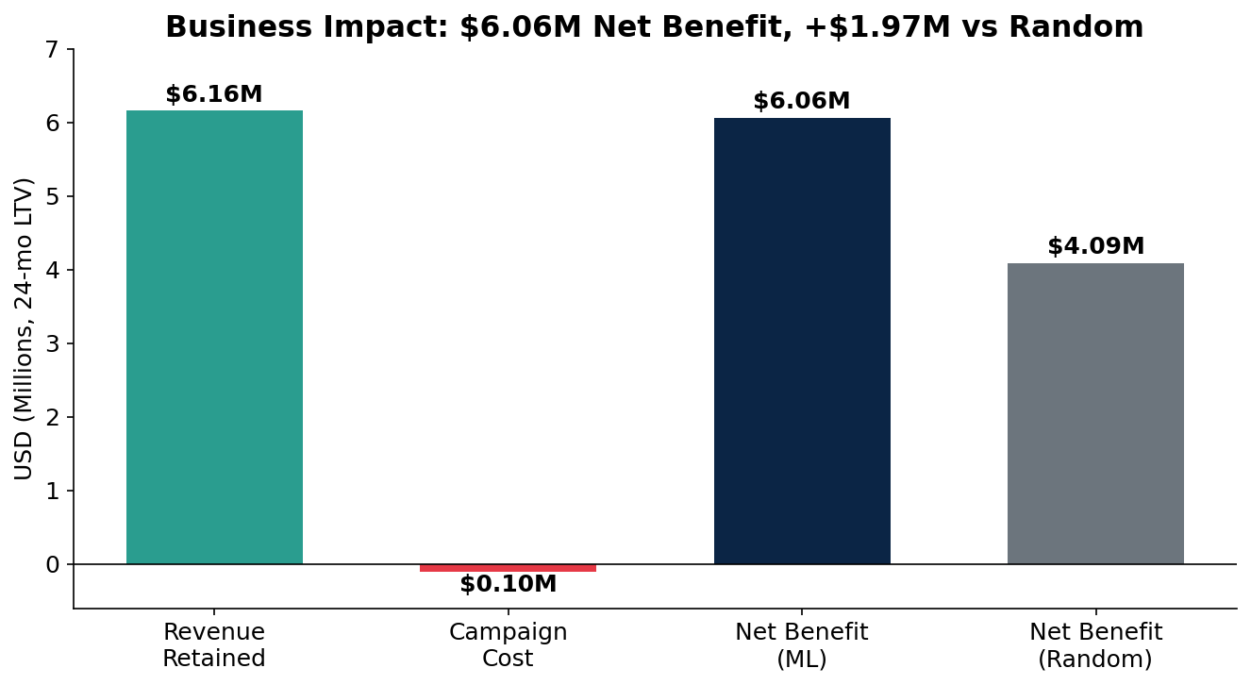
THE BUSINESS CASE
Quantified Impact
TOP-20% CAMPAIGN
▪ 20,000 customers contacted
▪ 73% precision → 14,560 churners reached
▪ 30% save rate → ~4,368 retained
▪ $58.72 avg monthly revenue / customer
▪ 24-month lifetime-value horizon
$6.0M net benefit · +$2.0M vs. random
Assumptions: 30% campaign success, $5/contact, 24-mo LTV, avg revenue from data. Conservative, stated for transparency.
12

Slide 13
FROM POC TO PRODUCTION
Next Steps & Risks
Phased roadmap
Risks & mitigations
▪ Phase 1 (0–1 mo): A/B test the top-20% campaign on a hold-out segment to measure true save-rate.
▪ Phase 2 (1–3 mo): Feed results back; tune offers by churn driver; add SHAP for per-customer explanations.
▪ Phase 3 (3–6 mo): Automate monthly scoring; try XGBoost/LightGBM & uplift modeling; retrain to counter drift.
▪ Model drift → scheduled monthly retraining.
▪ Save-rate uncertainty → validate via controlled A/B test before scaling.
▪ Offer cannibalization → cap discounts; target by risk driver, not blanket.
▪ Data quality / privacy → governance review; the model uses only provided, consented data.
13

Slide 14
SOURCES & CITATIONS
References
[1] IBISWorld / Statista (2024). U.S. Wireless Telecommunications Carriers — Market Size.
[2] McKinsey & Company. Reducing churn in telecom through advanced analytics.
[3] Harvard Business Review. The Value of Keeping the Right Customers (Gallo, 2014).
[4] Reichheld, F. & Sasser, W. E. Zero Defections: Quality Comes to Services, HBR; Bain & Company.
[5] Dataset: Company A (anonymized telecom) PoC dataset — GCI World 2026 course materials.
[6] Pedregosa et al. (2011). Scikit-learn: Machine Learning in Python. JMLR 12.
[7] Friedman, J. (2001). Greedy Function Approximation: A Gradient Boosting Machine. Annals of Statistics.
[8] Course lecture notebooks, Matsuo–Iwasawa Lab (GCI World 2026 April).
Generative AI (Claude, Anthropic) was used to assist with structuring and visualization; chat URL listed in the Omnicampus References field.
14

